Slide 1
2024 Committee Meeting Current Continuity in Auroral System Science: A 3D Modelling Approach to Current Closure in Non-Sheetlike Auroral Arcs
Jules van Irsel
Committee: Kristina Lynch, Yi-Hsin Liu, James LaBelle, Matt Zettergren
March 4, 2024

Slide 2
Thesis Statement
The scope of this work will address the incomplete description of auroral arcs that stray from their basic, sheet-like morphology. The aim is to find physical, self-consistent solutions to the ionospheric current continuity equation using state-of-the-art ionospheric 3D modelling to provide insight into the role the ionosphere plays in MI coupling for less idealized auroral events. In particular, knowing the portions of FAC closed by Pedersen currents, which produce collisional Joule heating, versus Hall currents, which are non-dissipative, gives insight into the extent to which the ionosphere acts as a load to a magnetospheric generator auroral ionosphere plays a non-passive role in this coupling.

Slide 3
Science Questions & Objectives
SQ 1: What self-consistency constraints exist in creating a geophysically coherent set of F-region quasistatic auroral system drivers?
SQ 2: What understanding of auroral system science can be gained by investigating the 3D morphology of ionospheric current closure?
SQ 3: What degree of along-arc structure significantly breaks the sheetlike discrete auroral model and what auroral features are most sensitive to this structure?
SO 1: Develop a public catalog of theoretical and data driven 3D auroral arc system simulations that illustrate non-idealized, non-sheetlike morphologies.
SO 2: Develop infrastructure to systematically drive and query the GEMINI ionospheric model such that the catalog can be easily expanded upon.

Slide 4

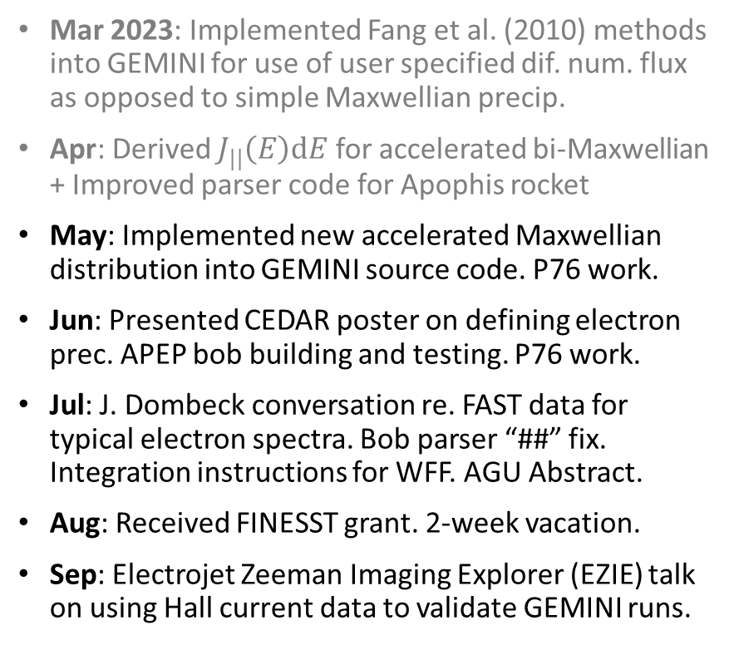



Progress Summary
Mar 2023: Implemented Fang et al. (2010) methods into GEMINI for use of user specified dif. num. flux as opposed to simple Maxwellian precip.
Apr: Derived $J_{||}\left(E\right)dE$ for accelerated bi-Maxwellian + Improved parser code for Apophis rocket
May: Implemented new accelerated Maxwellian distribution into GEMINI source code. P76 work.
Jun: Presented CEDAR poster on defining electron prec. APEP bob building and testing. P76 work.
Jul: J. Dombeck conversation re. FAST data for typical electron spectra. Bob parser “##” fix. Integration instructions for WFF. AGU Abstract.
Aug: Received FINESST grant. 2-week vacation.
Sep: Electrojet Zeeman Imaging Explorer (EZIE) talk on using Hall current data to validate GEMINI runs.
Oct: Started paper 1 on “reconstruction” (ARCS formalization) and “replication” for data driven catalog runs. Finding div-free flow = hard.
Nov: Automated use of GEMINI w/ Slurm for cluster computing. Organized MATLAB functions in prep. for public use. Helped fix GEMINI boundary issues.
Dec: Presented AGU poster on how to drive GEMINI with data using the “replication” technique.
Jan 2024: Got a cold. APEP 2 bob building. Lots of paper writing + figure making + code fixing. Running into flux conservation issues.
Feb: Got another cold. Almost finished paper 1 draft. First PFISR + Swarm replication done. First run done on HEC.
Winter term: Mentoring Giselle Wu (‘27) to take over certain aspects of GEMINI at Dartmouth.

Slide 5
First Paper
To make a catalog of data driven runs, we need ability to so.
Methods for creating electrostatic, continuous, 2D, topside F-region plasma flow maps:
“Reconstruction” for 2D distributed “CubeSwarm” of plasma flow data (ARCS).
“Replication” for one or more tracks of 1D plasma flow data (Isinglass, Swarm, PFISR, GNEISS).
Both in conjunction with multi-spectral, all-sky imagery (DASC).

Slide 6
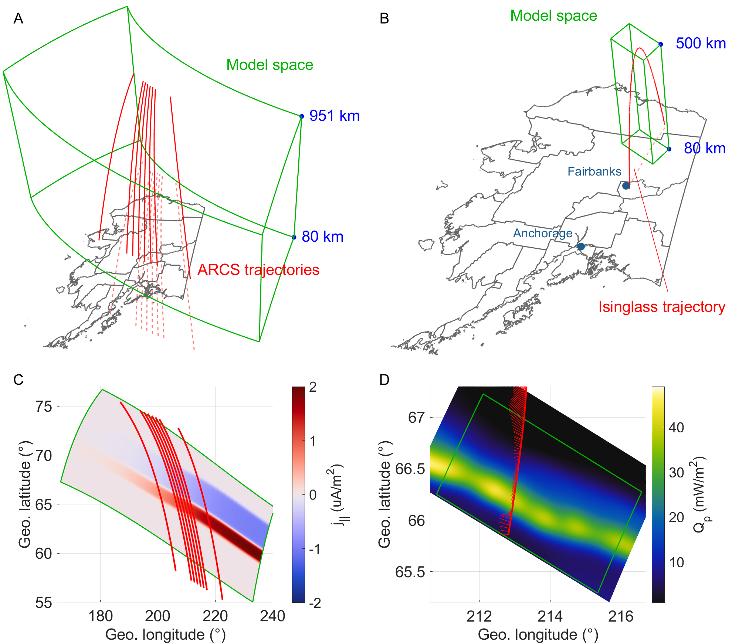
Context
Reconstruction example uses virtual ARCS spacecraft scraping flow data from an Observing System Simulation Experiment (OSSE).
Replication example uses Isinglass data with Poker Flat DASC imagery.
Imagery: UAF GI’s Poker Flat DASC. Flow data: Isinglass (P.I. K. Lynch)

Slide 7
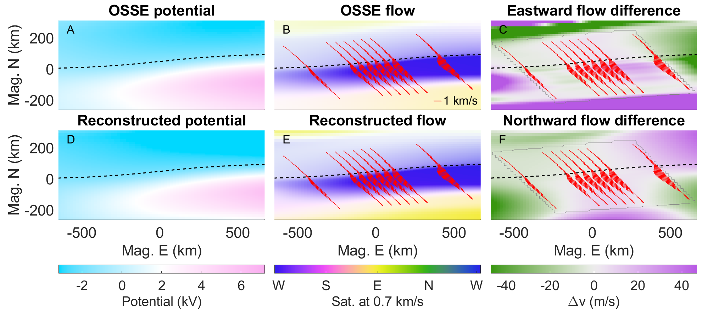
Reconstruction results

Slide 8
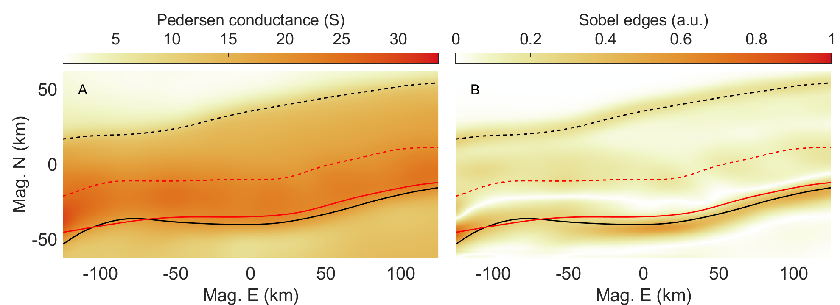
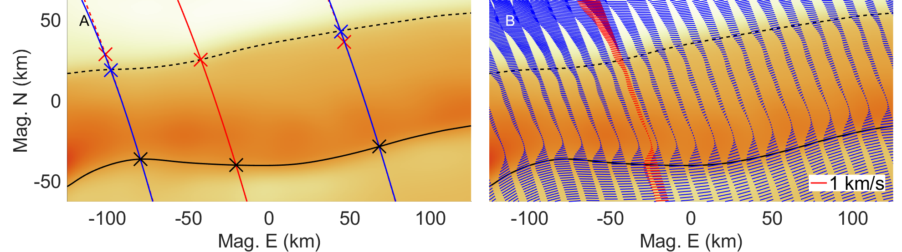
Replication & Defining Arc Boundaries
Energy flux largest gradients
Pedersen conductance contour lines

Slide 9
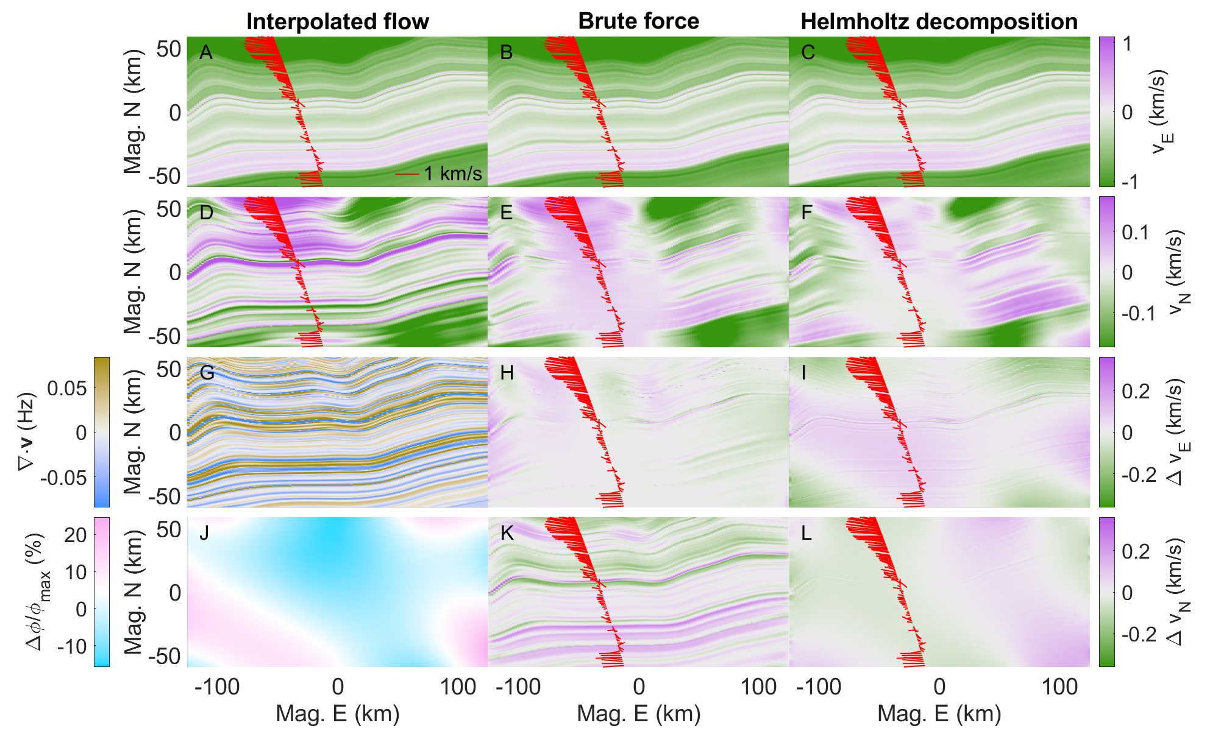
Enforcing Divergence-less Plasma Flow
Hours
Seconds

Slide 10
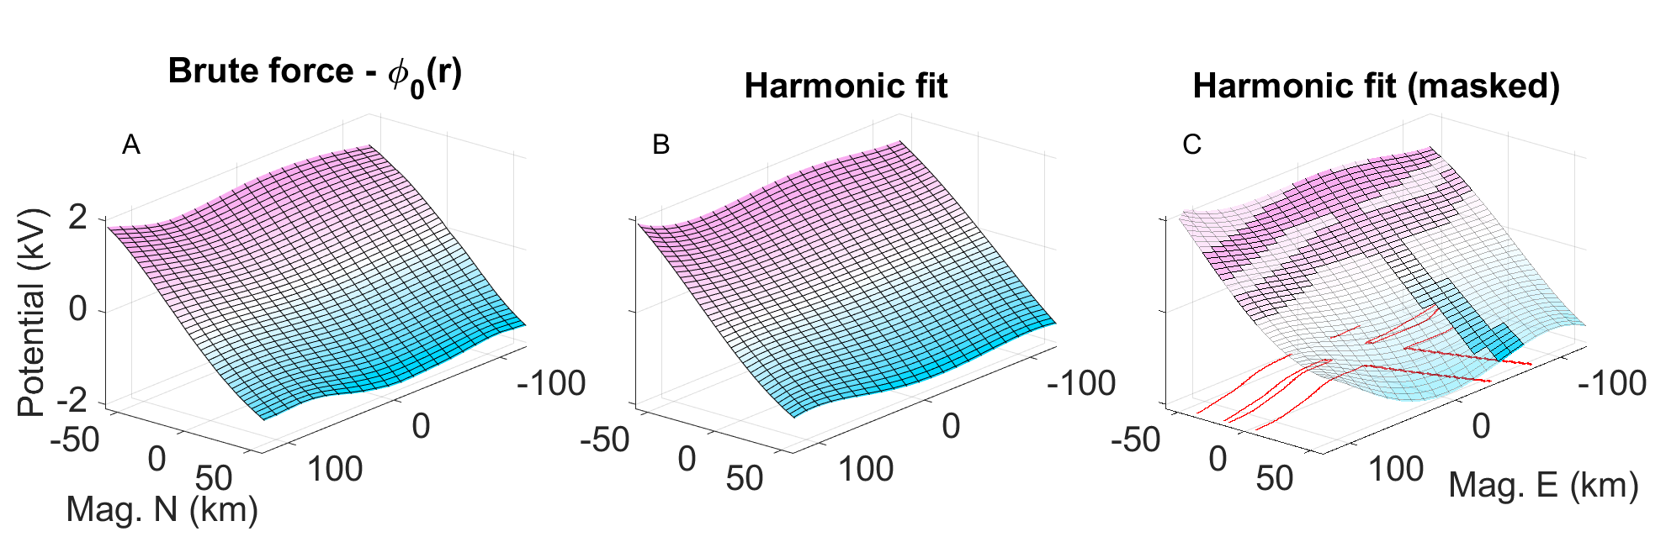
Harmonic Function Fitting

Slide 11
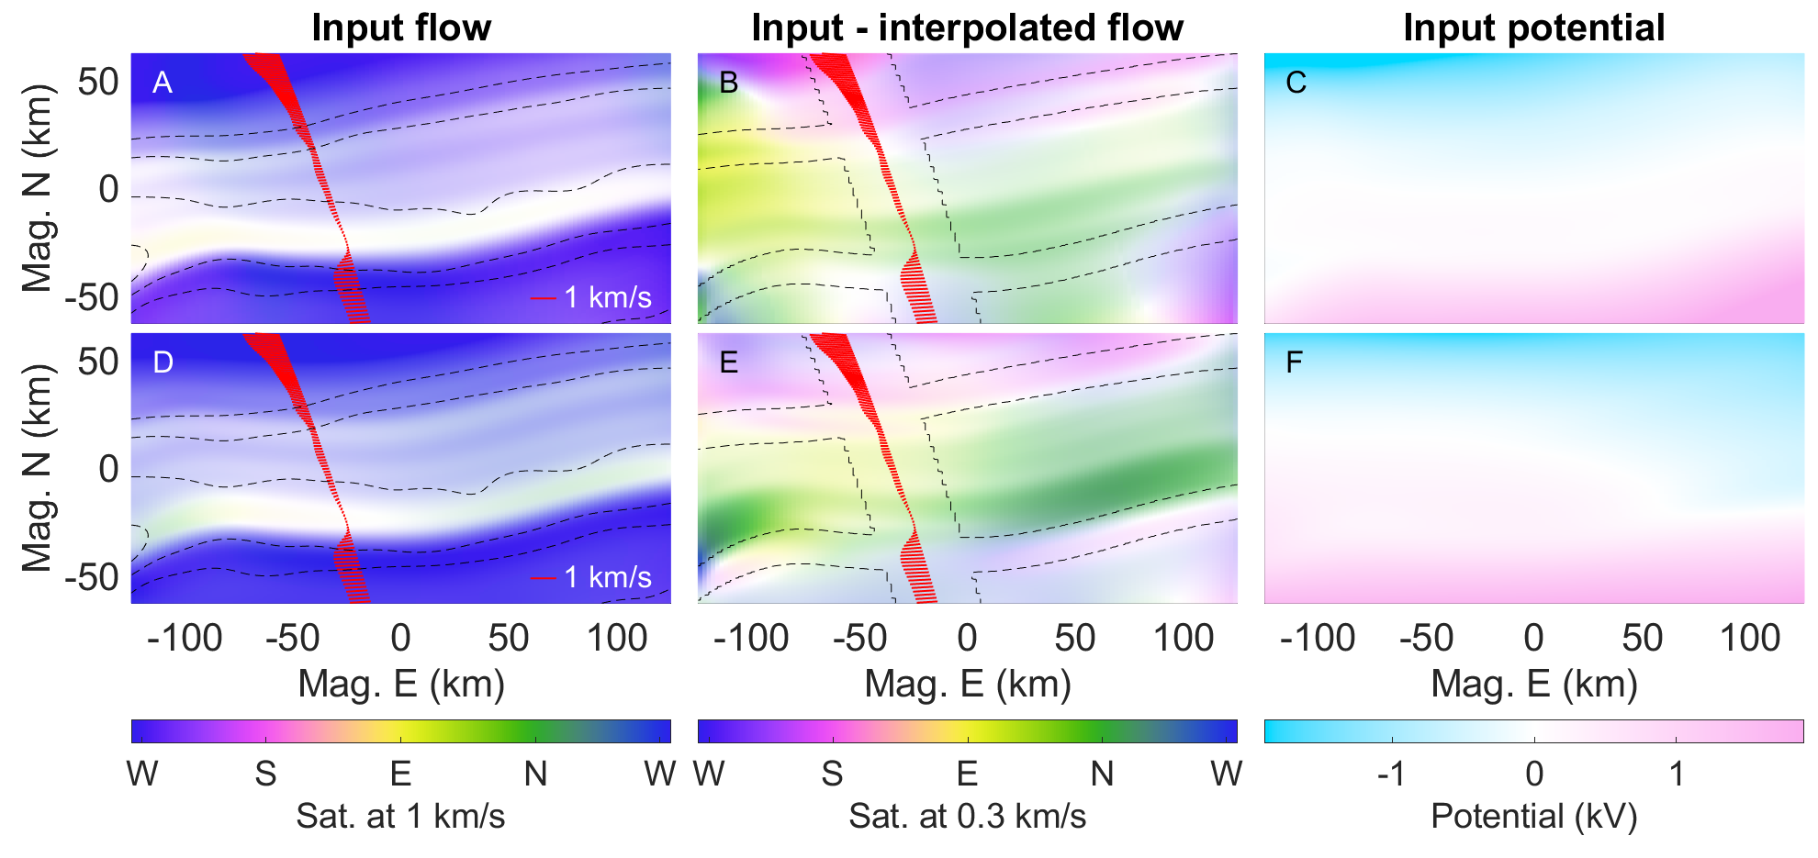
Replication Results

Slide 12
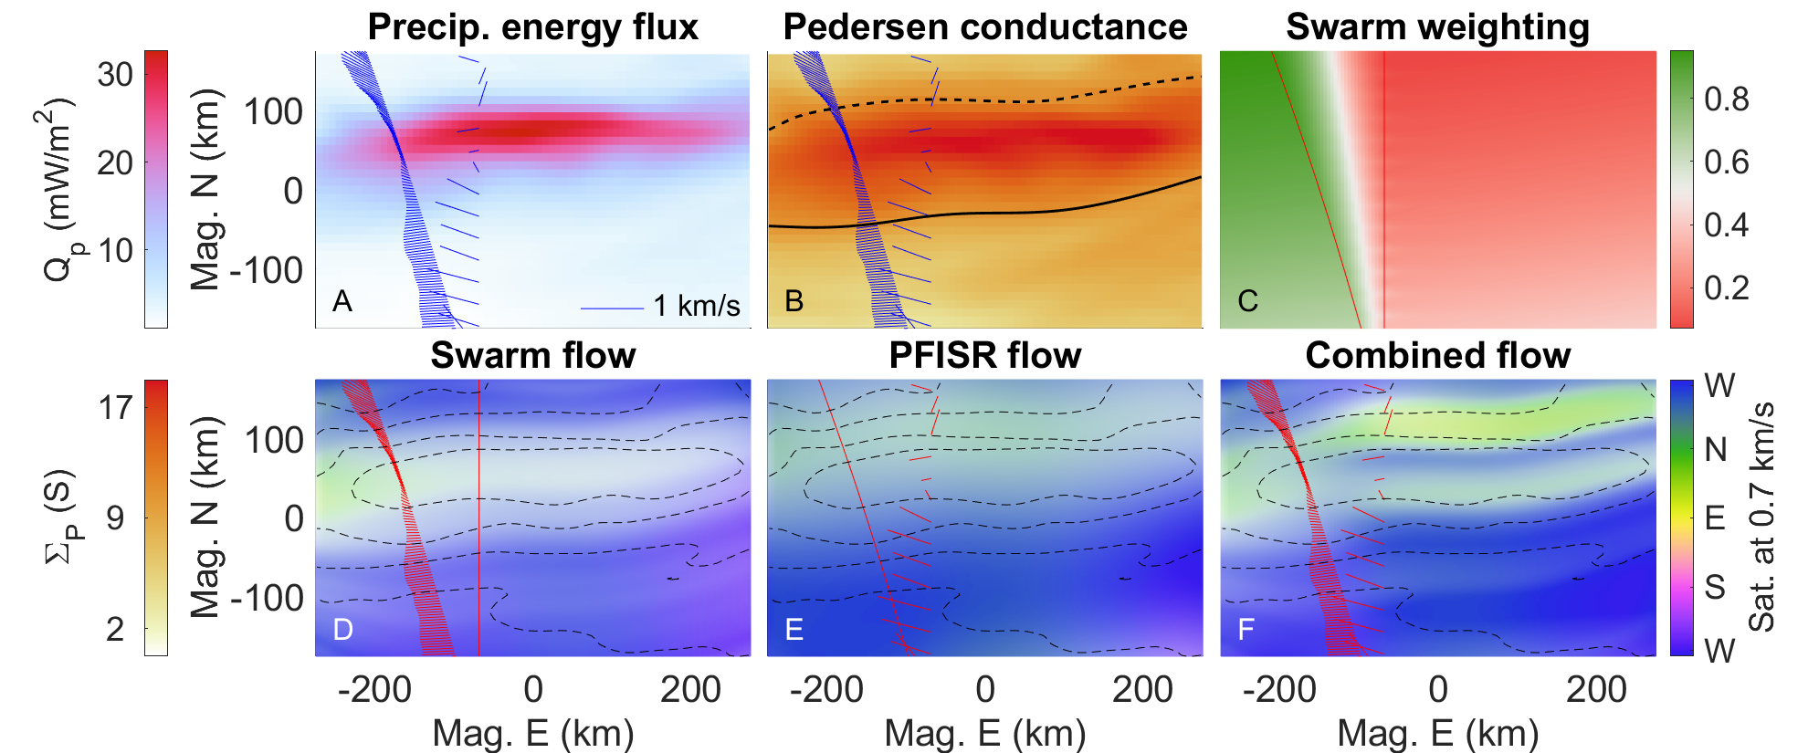
Double Replication Results
Imagery: UAF GI’s Poker Flat DASC. Flow data: ESA’s Swarm TII and AMISR’s PFISR.

Slide 13
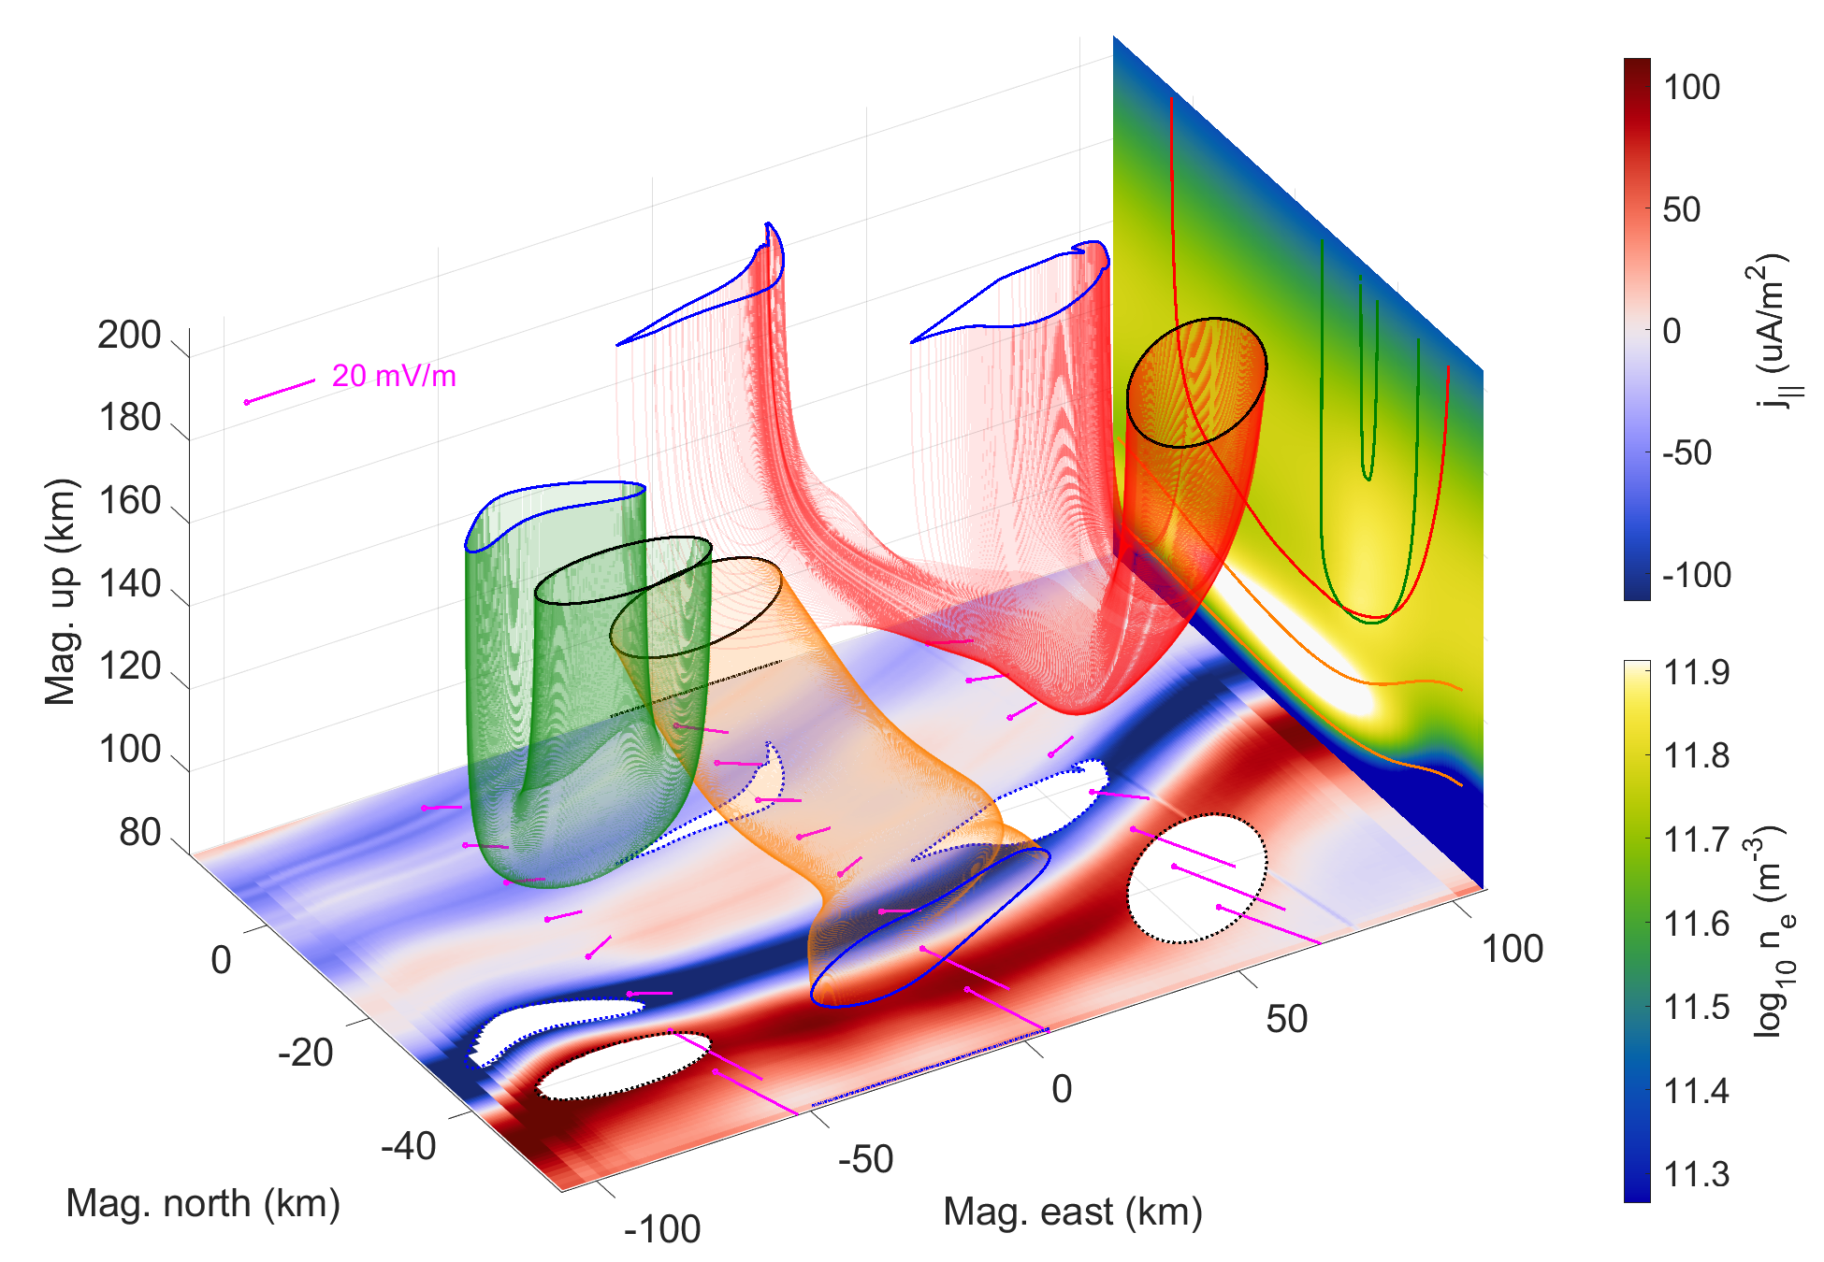
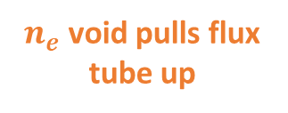
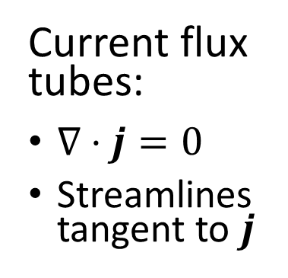
Split closure
Hall detour
GEMINI Results
Stereotypical Pedersen closure
Current flux tubes:
$∇⋅j=0$
Streamlines tangent to $j$
Diverging Hall current into Pedersen
$n_{e}$ void pulls flux tube up

Slide 14
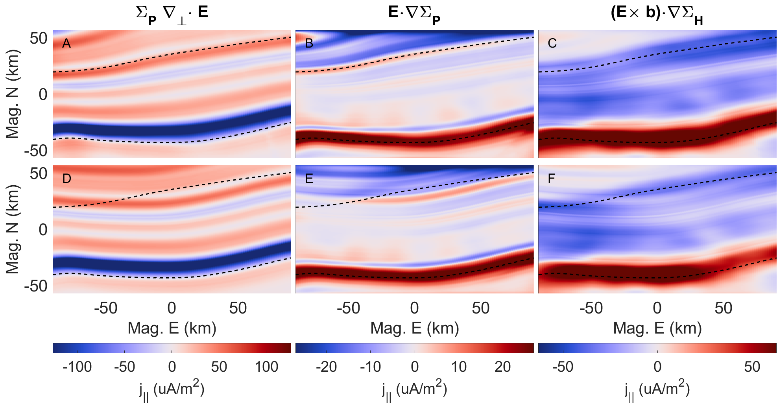
GEMINI Results: Current Continuity
Secondary boundary permeates through

Slide 15

Future work from last meeting
Before Aug 2023
Add low energy tail to acc. Maxwellian through Evans (1974) or Meier (1989)
Push request new GEMINI code snippets to public
Write paper on 3D morphology findings
Aug 2023 – Aug 2024
Run ~1000 of GEMINI runs (10 categories x 10 parameters/category x 10 values per parameter)
Further develop tools for analyzing morphological parameters
Submit a paper on findings
Aug 2024 – Aug 2025
Gather and setup GEMINI to run with data drivers (DASC + rockets + SWARM)
Submit a paper on findings

Slide 16
Remaining work
Submit paper 1.
Set up to run simulations on HEC and resolve resolution issues.
Submit paper 2 on 3D morphology findings from select simulations (sensitivity study).
Push request new GEMINI code snippets to public
Run ~1000 of GEMINI runs (10 categories x 10 parameters/category x 10 values per parameter) based on paper 2 findings.
Further develop tools for analyzing current flux tube morphological parameters.
Submit paper 3 on input parameters vs. morphological parameters + data driven vs. data inspired current continuity.
Submit dissertation between December 2024 and May 2025.

